Slide 1
Democratic Swarms: Navigating Collision Avoidance through Consensus Decision-Making with the Voter Model
NAME- AYUSH PANDEY
LAB –MULTIAGENT SYSTEMS DESIGN LAB
SUPERVISOR- DR. MUNEENDRA OJHA

Slide 2
INTRODUCTION
In hurdle avoidance, the Voter Model is used to model agents' opinions on obstacle avoidance strategies.
Through interactions and opinion updates, agents dynamically adjust their routes to avoid obstacles, leading to efficient and adaptive navigation.

Slide 3
SWARM ROBOTICS
Swarm robotics is a field of robotics that draws inspiration from the behavior of social insect colonies, such as ants, bees, and termites, to design and study multi-robot systems.
It is based on the idea that a group of relatively simple and homogeneous robots, called agents, can achieve complex tasks through decentralized coordination and self-organization.

Slide 4
VOTER MODEL
The Voter Model is a widely studied and fundamental model in statistical physics, social dynamics, and opinion formation. It describes the dynamics of opinion formation in a population where individuals, called voters, can adopt one of two possible opinions, typically denoted as "0" and "1."
The Voter Model is governed by simple rules of opinion update and interaction, and it exhibits interesting emergent behavior.

Slide 5
TARGET SITES
Target sites are locations in the environment that swarm robots aim to reach or achieve specific objectives.
In the simulation, target sites are represented by red rectangles on the screen.
Two target sites, denoted as "A" and "B," are positioned at different locations to create distinct goals for the agents.

Slide 6
AGENTS
Agents are individual robots in the swarm, each capable of independent movement and decision-making.
In the simulation, agents are represented by blue circles.
They start from a common origin point and dynamically navigate towards the target sites based on opinion dynamics.

Slide 7
MOVEMENT TOWARDS TARGET
Agents move towards target sites by calculating the direction vector towards the target.
The direction vector is normalized to determine the movement speed of each agent.
Agents dynamically adjust their positions based on the direction vector to approach the target site.

Slide 8
REPULSION FROM HURDLES
Agents avoid obstacles (hurdles) using repulsion forces.
Hurdles are moving obstacles with defined positions, amplitudes, and oscillation frequencies.
Agents calculate their distance to the hurdles and adjust their movement direction to repel away from the obstacles.

Slide 9
MOTION PHASES
Agents move to target A (upper target).
Agents return to the origin point.
Agents move to target B (lower target).
Agents return to the origin point again.
Agents reach consensus on the target with shorter motion time from phases 1 and 3.

Slide 10
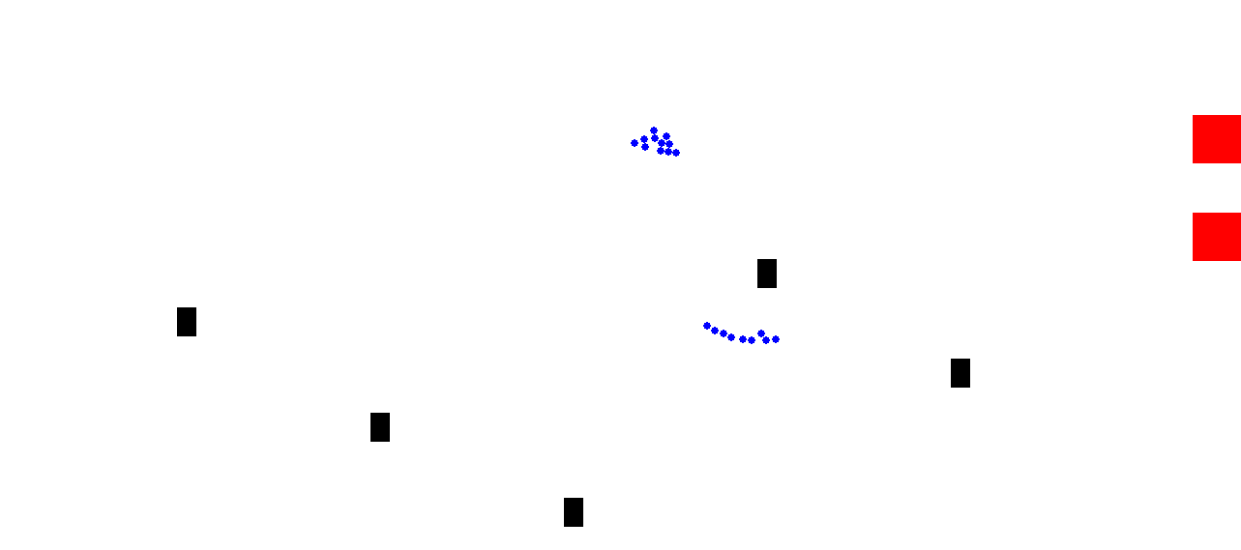
VISUALIZATION

Slide 11
OPINION EXCHANGE AND CONSENSUS
During motion phases 1 and 3, agents dynamically adjust their opinions based on the time taken to reach each target.
After motion phases 1 and 3, opinion exchange and consensus are achieved through interactions between agents.
Agents either adopt the opinion of a randomly selected neighbor or maintain their current opinion based on the selected neighbor's preference.

Slide 12
ADVANTAGE OF VOTER MODEL
Voter model highlights the importance of collaboration and adaptability in swarm robotics.
Agents collectively decide on the optimal target and adapt their routes to navigate around obstacles for efficient and successful task completion.

Slide 13
CONCLUSION
The simulation based on the Voter Model and Swarm Robotics principles showcased the dynamic behavior of agents in reaching consensus on target selection while avoiding obstacles (hurdles).
The agents demonstrated efficient movement towards the target sites, adapting their paths in real-time to avoid collisions.

Slide 14
REFERENCE
https://en.wikipedia.org/wiki/Voter_model
​https://en.wikipedia.org/wiki/Swarm_robotics
M. Brambilla, E. Ferrante, M. Birattari, and M. Dorigo. Swarm robotics: a review from the swarm engineering perspective.
http://www.scholarpedia.org/article/Swarm_robotics
G. Valentini, H. Hamann, and M. Dorigo ​Self-Organized Collective Decision Making: The Weighted Voter Model ​

Slide 15
THANK YOU

